Slide 1

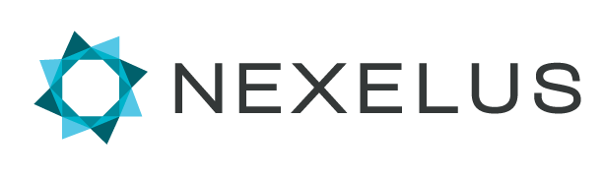
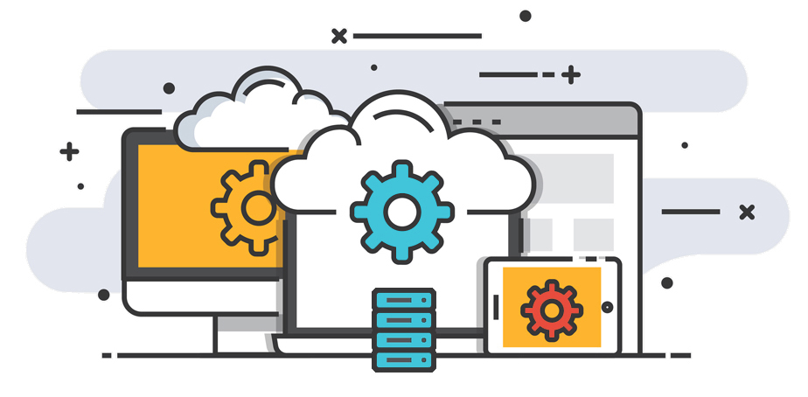
DCM, Facebook, BING, AdWords, Trade desk, Sizmek & Twitter
Instructions for Set up of API Integrations with Nexelus for:

Slide 2
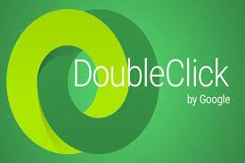
Linking Nexelus & DCM

Slide 3
DCM Sites
Our login Nexapi@nexelus.net has API read only access to the Test account/network. We need following access
Full Read access
Write access to create/edit Campaigns, placement/packages and Ads.
DCM: If the new client is using DCM, we need the ‘write’ access to DCM live accounts. See slides 4-8

Slide 4
Steps
Add a Nexelus User Nexapi@nexelus.net to DCM with required access & permissions
Send Nexelus list of DCM Sites

Slide 5
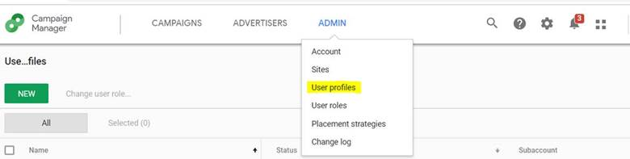

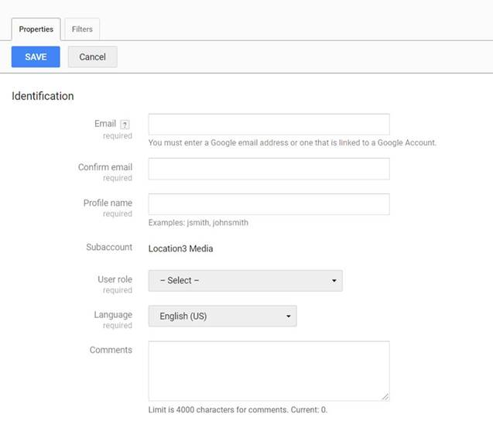
Add a Nexelus User to DCM
Click on “Admin” menu and select User profiles
Click on “New” button; this opens a window for new profile
Enter Information in newly opened window
Enter Nexapi@nexelus.net in email and confirm email field
Enter profile name. You can use any name, however it’s preferred to use “Nexelus_Account” where account is DCM account number
Select appropriate role
You can use the default role “Agency Media Planner”. Or create a new role; see next slide for Permissions needed.
Select “Filter” tab, where you can filter data which this profile can access, you can select “Allow all” for all categories if you want to give this profile access to all data under this account
Press “Save” button to save profile

Slide 6
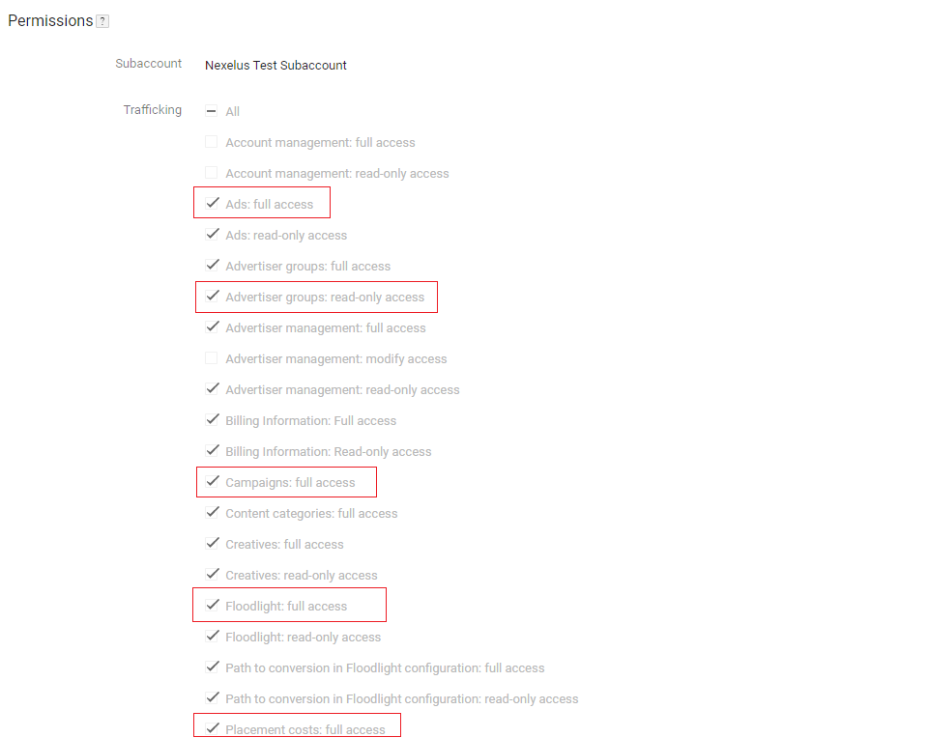
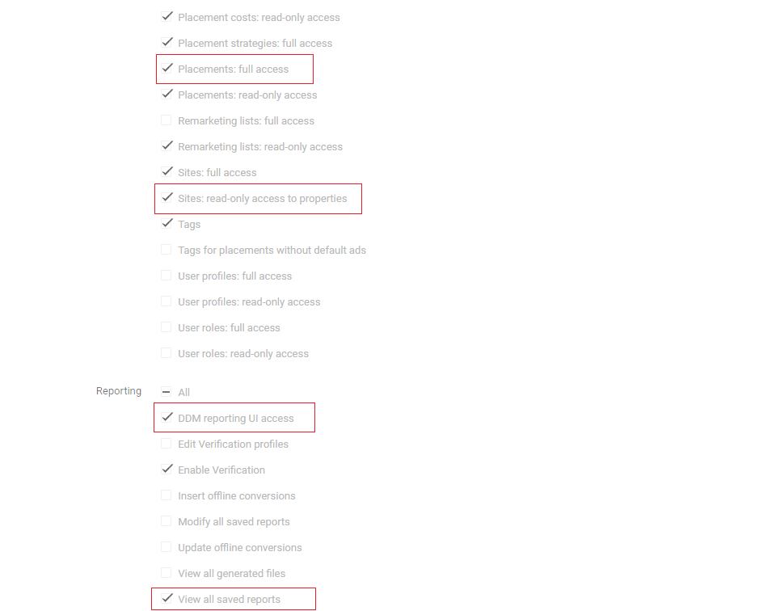
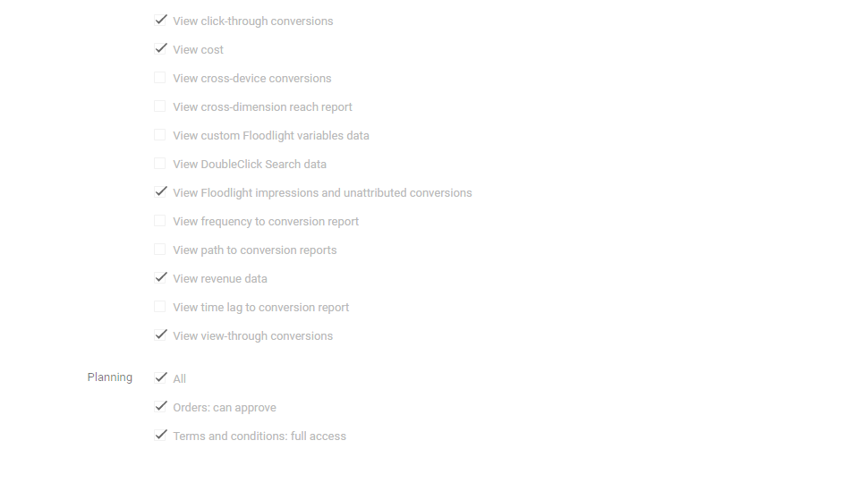
Needed Permissions
If choosing to create a new User Role for Nexelus, please ensure they are provided the permissions indicated in the screenshots by red boxes

Slide 7
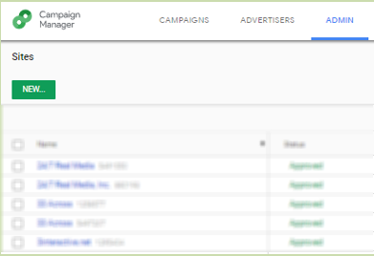
DCM Sites
Please provide Nexelus with a list of DCM Sites (and their IDs) from the Network which company may be expect to use in the future.
We will set these up in Nexelus.

Slide 8

Linking Nexelus & Facebook

Slide 9
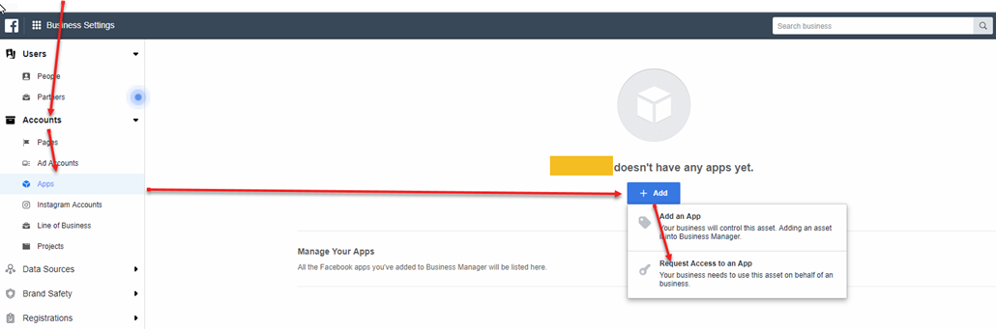
Facebook
Add Facebook NEXELUS App:
To add the Nexelus App in Facebook. The Facebook Admin needs to follow the below steps:
In the Business Settings, click on Accounts >> Apps then click on Add button, in the drop-down menu click on “Request Access to an App”.

Slide 10
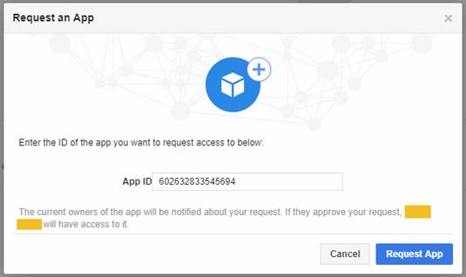
Facebook
In the pop up fill out the field using Nexelus App ID 602632833545694. Once, Nexelus approve the request you should see the app appear on the Apps screen.

Slide 11
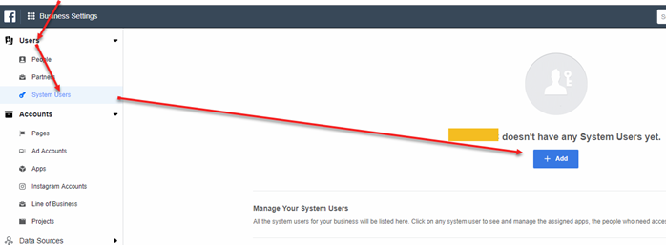
Facebook
Once the permission is granted. You will need to create a system user.

Slide 12
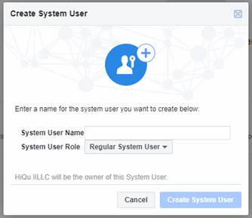
Facebook
In the popup “Create System User”. Please name the user “Nexelus” and keep the system User Role to “Regular System User”.

Slide 13
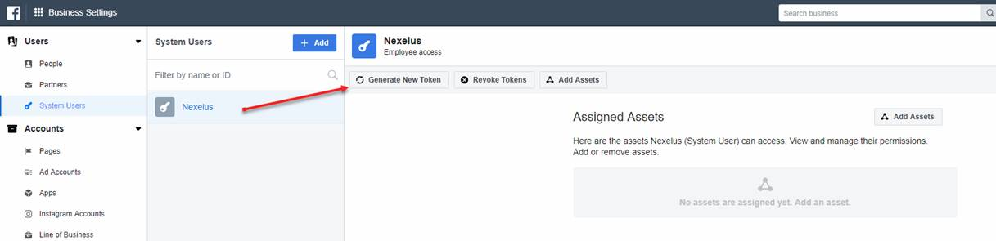
Facebook
After the user is created. Please select the user and generate a token.

Slide 14
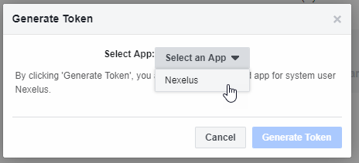
Facebook
In the pop up, select the Nexelus app.

Slide 15
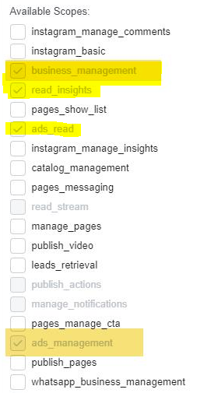

Facebook
After the App is selected. Please check of the following settings and then click on “Generate Token”

Slide 16
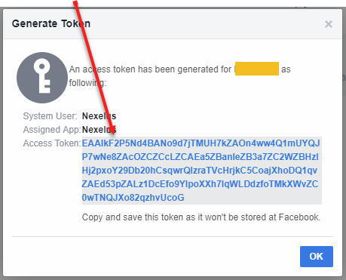
Facebook
After the token is generated, please provide the “Access Token” to Nexelus.

Slide 17
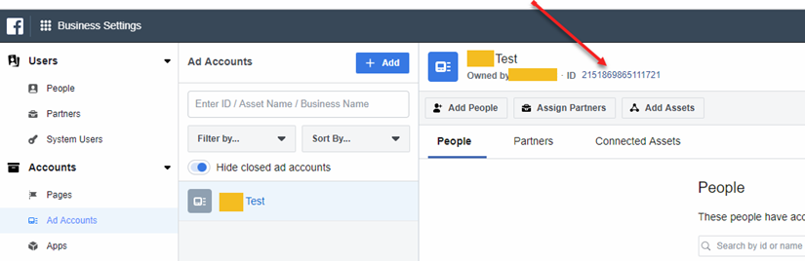
Facebook
Please also provide your Ad Account ID that you would like Nexelus to pull delivery data from. This is located under Accounts >> Ad Accounts.

Slide 18
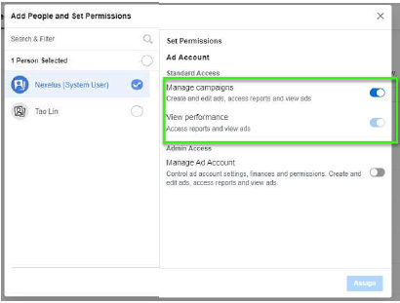
Facebook
In the Ad Accounts, please add the System User “Nexelus” in the Ad Account and grant only view performance access.

Slide 19
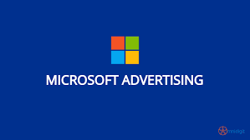
Linking Nexelus & Microsoft Ads

Slide 20
Microsoft Ads access
We need access to Microsoft Advertisement in order to pull delivery and create IOs.
We need access to your account
Please add Nexelus email address "Nexapi@nexelus.net"
Do you have a developer token for Microsoft Advertisement?
If so please provide us.
If not please generate. Here is a link on how to do it. Let us know if our assistance is required.

Slide 21

Linking Nexelus & AdWords

Slide 22
Google Ads
We have all access. However, please specify an account that we can use for testing.
Important note for Google Ads:
We need to firm-up on below two points:
Confirmation, if the new client is part of Main MCC or if it has a separate MCC of it’s own
Confirmation, if the new client is already whitelisted for API integration by Google. If not please ask your rep to whitelist.
Whitelisting a MCC
1- Get a developer token from Google Ads which will allow us to integrate. If you already have a developer token for a client’s MCC then simply provide us with Token and password.
To get a new developer token, please fill this form as detailed on sign-up page.
Check with your Google rep or Google API team if your MCC is whitelisted for Budget Order API (for budget order service API, i.e. ability to create Budget Order from Nexelus)
Note that the 360i Master MCC is already whitelisted for Budget Order creation.
Use attached Design document when signing up for developer token or whitelisting MCC.
2- Access level: We will need “Basic” access for the API.
3- Once we have the access please allow “Permissible” usage for ‘Ad creation / management’ and ‘Reporting’. Application link can be found here.

Slide 23

Linking Nexelus & Twitter

Slide 24
Twitter
Login to twitter developer account on https://developer.twitter.com
Creating a Project
To create a Project, click on “New Project” in your dashboard or the Projects & Apps page within the developer portal. You’ll only be able to see this option if you haven’t already created a Project. You will be prompted to create a Project name, description, and use case. You will also be asked to create a new App or connect an existing standalone App
Creating or Connecting an App for your Project
Accessing the Twitter Ads API endpoints requires a set of authentication credentials, also known as keys and tokens, that you must pass with each request.
Each Project can contain an App, with which you can generate authentication credentials (keys and tokens).
If your Project doesn’t include an App, you can add one by clicking on the Project name in the dashboard. From there, you can create a new App. The App is where you can generate your authentication keys and tokens, including the API Key and API Secret, Access Token and Access Token Secret. You can add a maximum of 10 apps to your project.

Slide 25
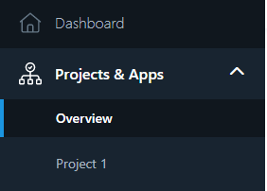
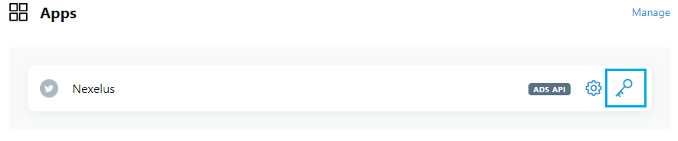
Twitter
From the left menu, under Projects & Apps, click on the project. It will display the Apps in that project.
Click on Keys and Token icon.

Slide 26
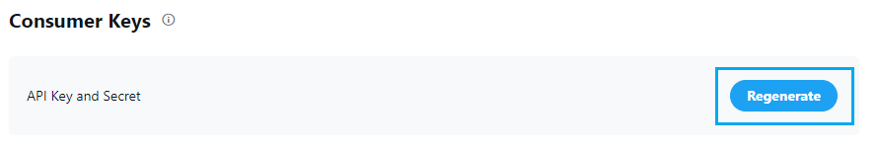
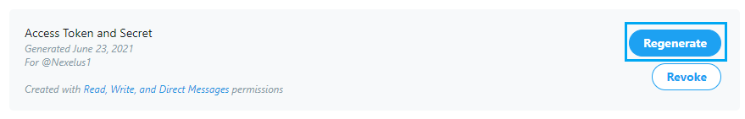
Twitter
Generate two Consumer keys as API Key and API Secret and save somewhere
Generate two Authentication tokens as Access Token and Access Secret and save somewhere
Provide the generated 4 keys to Nexelus consultant.
Please note that you cannot regenerate these Keys once provided to Nexelus as it will create new credentials and invalidate the old ones. This means that any integrations that have been setup with prior credentials have to be updated.

Slide 27
Linking Nexelus &
Display & Video 360

Slide 28
Display & Video 360
Important note for DV360:
We need to firm-up on below point:
Confirmation, if the new client is already whitelisted for API integration by Google. If not please ask your rep to whitelist.
Whitelisting
1- Get a developer token from DV360 which will allow us to integrate. If you already have a developer token for a client, then simply provide us with Token and password.
To get a Application name, click to the link to configure a Google API Console project. Check with your DV360 rep or DV360 API team if your account is whitelisted for Budget Order API (for budget order service API, i.e. ability to create Budget Order from Nexelus)
Use attached Design document when signing up for developer token or whitelisting.
2- Access level: We will need “Basic” access for the API.
3- Once we have the access please allow “Permissible” usage for ‘Ad creation / management’ and ‘Reporting’. Application link can be found here.

Slide 29

Linking Nexelus &

Slide 30
The Trade Desk
Obtain API Credentials: You need to sign up with The Trade Desk and obtain API credentials. To create an account, you need to provide your name, email address, phone number, company name and address, and other information by going into The Trade Desk website and fill the form.
After your account is set up, you'll receive an activation email with your API credentials. Please provide us the credentials that will allow us to access both the sandbox and production environments.
Reference: https://partner.thetradedesk.com/v3/portal/api/doc/ApiPlatformGetStarted

